Slide 1

Application Layer (Electronic Mail &DNS)
Lecture 3
CSE421 – Computer Networks
Department of Computer Science and Engineering
School of Data & Science
All material copyright 1996-2020
J.F Kurose and K.W. Ross, All Rights Reserved

Slide 2

Application Layer :Objectives
Principles of network applications
Web and HTTP
Electronic mail
  SMTP, POP3, IMAP
DNS

Slide 3

Electronic mail
user
agent
Three major components:
user agents
mail servers
simple mail transfer protocol: SMTP
mail
server
user
agent
SMTP
mail
server
user
agent
SMTP
SMTP
user
agent
User Agent
Software program that is used for
composing, editing, reading, forwarding mail messages
e.g., Outlook, iPhone mail client, Web browser
mail
server
user
agent
user
agent
outgoing
message queue
user mailbox

Slide 4
Electronic mail: mail servers
user
agent
mail servers:
mailbox contains incoming messages for user
message queue of outgoing (to be sent) mail messages
mail
server
user
agent
SMTP
mail
server
user
agent
SMTP
SMTP
user
agent
SMTP protocol between mail servers to send email messages
client: sending mail server
“server”: receiving mail server
mail
server
user
agent
user
agent
outgoing
message queue
user mailbox

Slide 5


Scenario: Alice sends e-mail to Bob
1) Alice uses UA to compose e-mail message “to” bob@someschool.edu
4) SMTP client sends Alice’s message over the TCP connection
2) Alice’s UA sends message to her mail server using SMTP; message placed in message queue
5) Bob’s mail server places the message in Bob’s mailbox
3) client side of SMTP at mail server opens TCP connection with Bob’s mail server
6) Bob invokes his user agent to read message using POP3 or IMAP.
**if connection fails, it keeps retrying for few days
user
agent
mail
server
user
agent
1
mail
server
SMTP
2
3
6
4
SMTP
POP3 or IMAP
Alice’s mail server
5
Bob’s mail server

Slide 6
Electronic Mail: SMTP [RFC 2821]
“client”
SMTP server
“server”
SMTP server
uses TCP to reliably transfer email message from client to server, port 25
  direct transfer: sending server (acting like client) to receiving server
three phases of transfer
  SMTP handshaking (greeting)
  SMTP transfer of messages
  SMTP closure
command/response interaction (like HTTP)
  commands: ASCII text
  response: status code and phrase
initiate TCP
connection
RTT
TCP connection
initiated
220
SMTP handshaking
HELO
250 Hello
SMTP transfers
time

Slide 7
Sample SMTP interaction
S: 220 hamburger.edu
C: HELO crepes.fr
S: 250 Hello crepes.fr, pleased to meet you
C: MAIL FROM: <alice@crepes.fr>
S: 250 alice@crepes.fr... Sender ok
C: RCPT TO: <bob@hamburger.edu>
S: 250 bob@hamburger.edu ... Recipient ok
C: DATA
S: 354 Enter mail, end with "." on a line by itself
C: Do you like ketchup?
C: How about pickles?
C: .
S: 250 Message accepted for delivery
C: QUIT
S: 221 hamburger.edu closing connection
SMTP handshaking
SMTP header
SMTP Message Data Transfer
SMTP Termination

Slide 8
SMTP: final words
Comparison with HTTP:
HTTP: pull; SMTP: push
HTTP: Server to client; vice versa
SMTP: server to server
both have ASCII command/response interaction, status codes
HTTP: each object encapsulated in its own response message
SMTP: multiple objects sent in multipart message
SMTP uses persistent connections
SMTP requires message (header & body) to be in 7-bit ASCII
SMTP server uses CRLF.CRLF (\r\n.\r\n) to determine end of message

Slide 9
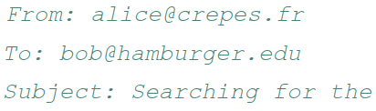
Mail message format
SMTP: protocol for exchanging email messages
RFC 822: standard for text message format:
header lines, e.g.,
  different from SMTP MAIL FROM, RCPT TO: commands!
Body: the “message”
  ASCII characters only
header
blank
line
body

Slide 10
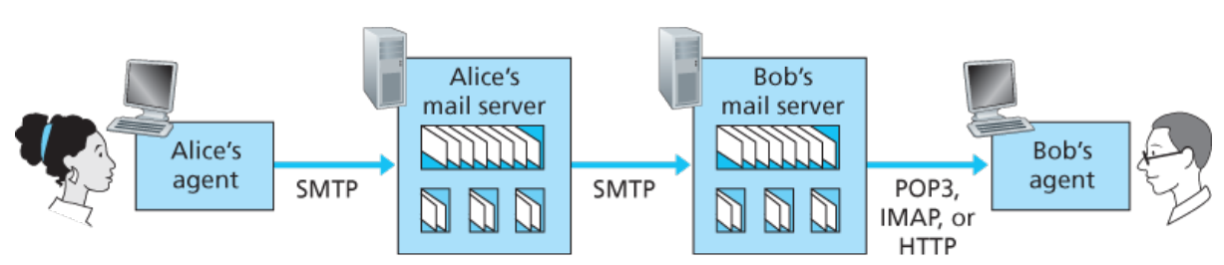
Mail access protocols
SMTP: delivery/storage to receiver’s server
Mail access protocol: retrieval from server
  POP: Post Office Protocol [RFC 1939]: authorization, download
  IMAP: Internet Mail Access Protocol [RFC 1730]: more features, including manipulation of stored messages on server
  HTTPs: Web based(Gmail, Hotmail, Yahoo! Mail, etc.)

Slide 11
POP3 vs IMAP
Features | POP3 | IMAP
Name | Post Office Protocol | Internet Message Access Protocol
Mail Location | Mail downloaded at the local workstation and deleted from the server. ** | Keeps all mails in one place: at the server
Accessing Mail | Mail can only be accessed using a single device at a time when using POP3. | Messages can be accessed via IMAP on a variety of devices
Update | POP3 does not allow users to create, delete, or modify mailboxes on the mail server. | IMAP allows the user to create, delete, or update mailboxes on the mail server, as well as create a folder hierarchy of mailboxes.
Readability | Once the message has been downloaded, we can only read it. | Before we finish the download, we can read the message in part.
Virus | Mail kept in workstation, vulnerable to any virus | Mails kept in server, less susceptible to virus
Port Number | 110 | 143
**POP3 “download-and-keep”: copies of messages on different clients

Slide 12
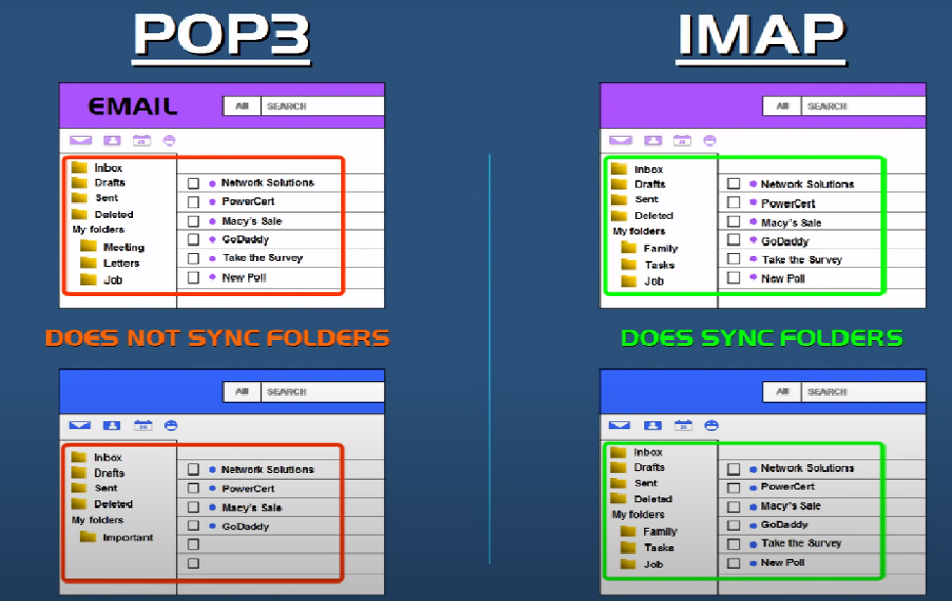
POP3 vs IMAP
Source : https://www.youtube.com/watch?app=desktop&v=SBaARws0hy4

Slide 13
IMAP | POP3
People check email from multiple devices (phone, laptop, tablet) | People checked email from only one computer
Internet is always available | Internet was slow
Server storage is large and affordable | Storage on server was limited
Users want real-time synchronization | Offline reading was important
Users need server-side folder management
Organizations require centralized email control

Slide 14
Application Layer :Objectives
Principles of network applications
Web and HTTP
Electronic mail
  SMTP, POP3, IMAP
DNS

Slide 15
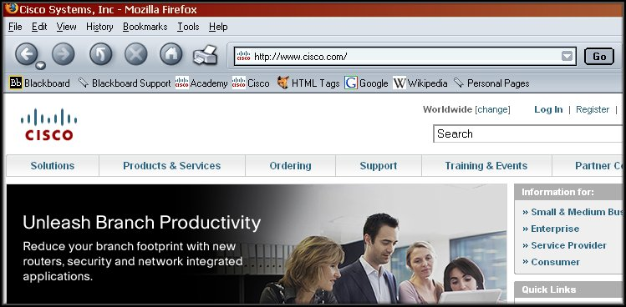
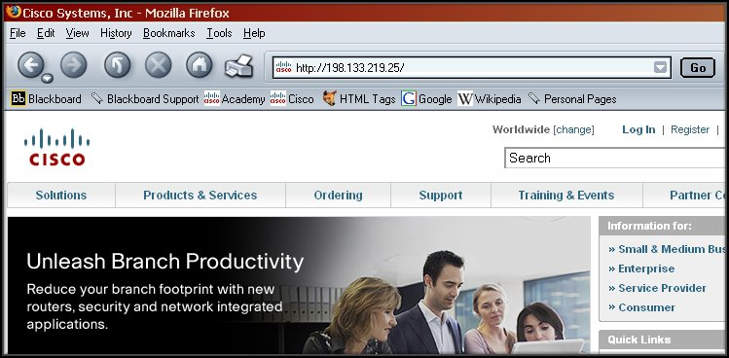
Domain Name System (DNS)
DNS is the phone book of the Internet.
15

Slide 16
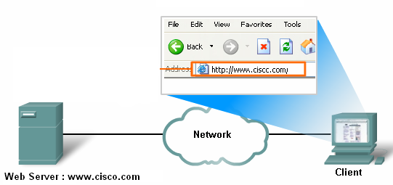
Domain Name System (DNS)
Dest MAC Address | Source MAC Address | Destination IP Address | Source IP Address | Destination Port No | Source Port No
 |  |  |  |  |  | Data: Request for web page | Trailer
?
192.168.1.1
80
51025
Web Browser application Port Number: 51025
www.cisco.com : ? IP address
Web Server application Port Number: 80
IP address : 192.168.1.1
IP address : 200.20.20.1
16

Slide 17


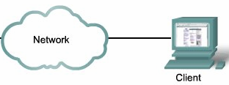
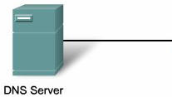
Domain Name System (DNS)
= ? IP address
Web Server : www.cisco.com
DNS Request
for IP address
DNS Reply:
www.cisco.com =
198.133.219.25
Packet ready
to be send
to www.cisco.com
DNS Address Book:
www.cisco.com = 198.133.219.25
www.yahoo.com = 200.133.2.56
17
Notes:
17
DNS and the Browser:
First, a domain name or URL is entered in the address field of the browser. The browser passes the name to the resolver.

Slide 18
Domain Name System (DNS)
DNS is an automated client/server service.
Internet programs requiring domain name look up send a resolution request to the DNS resolver (Client side of DNS) in the local operating system
The resolver in turn handles the communications required.
Web Browser
DNS
Resolver
Mail Client
Operating System
18

Slide 19

Thinking about the DNS
humongous distributed database:
~ billion records, each simple
handles many trillions of queries/day:
many more reads than writes
performance matters: almost every Internet transaction interacts with DNS - msecs count!
organizationally, physically decentralized:
millions of different organizations responsible for their records
“bulletproof”: reliability, security

Slide 20
DNS Name Servers
Centralized DNS?
Single point of failure
Traffic volume
Distance centralized database
Maintenance
Doesn’t scale!
Solution: Distributed Database
NO
REASONS ?
20

Slide 21
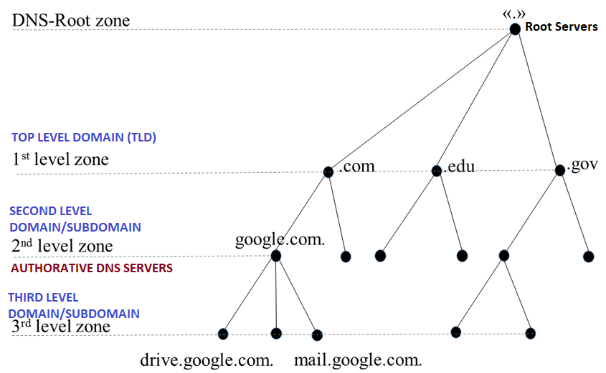
DNS: a distributed, hierarchical database
https://cse.sds.bracu.ac.bd/

Slide 22
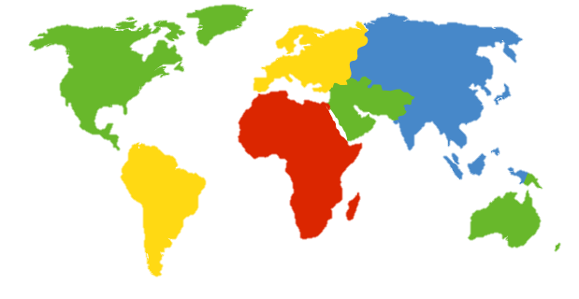
DNS: root name servers
Official, contact-of-last-resort by name servers that can not resolve name
Incredibly important Internet function
  Internet couldn’t function without it!
ICANN (Internet Corporation for Assigned Names and Numbers) manages root DNS domain
c. Cogent, Herndon, VA (5 other sites)
d. U Maryland College Park, MD
h. ARL Aberdeen, MD
j. Verisign, Dulles VA (69 other sites )
k. RIPE London (17 other sites)
i. Netnod, Stockholm (37 other sites)
e. NASA Mt View, CA
f. Internet Software C.
Palo Alto, CA (and 48 other sites)
m. WIDE Tokyo
(5 other sites)
13 logical root name “servers” worldwide each “server” replicated many times (~200 servers in US)
a. Verisign, Los Angeles CA
(5 other sites)
b. USC-ISI Marina del Rey, CA
l. ICANN Los Angeles, CA
(41 other sites)
g. US DoD Columbus, OH (5 other sites)

Slide 23
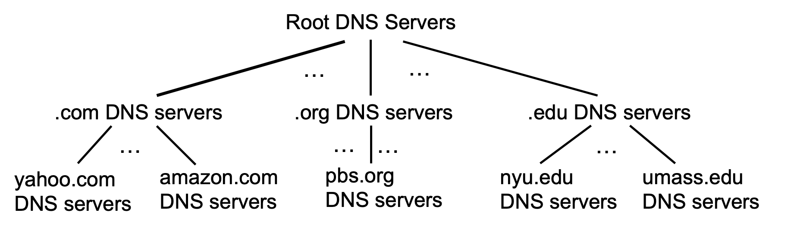
Top-Level Domain, and authoritative servers
Top-Level Domain (TLD) servers:
  responsible for .com, .org, .net, .edu, .aero, .jobs, .museums, and all top-level country domains, e.g.: .cn, .uk, .fr, .ca, .jp
  Network Solutions: authoritative registry for .com, .net TLD
  Educause: .edu TLD
Second Level Domain/Authoritative DNS servers:
  organization’s own DNS server(s), providing authoritative hostname to IP mappings for organization’s named hosts
  can be maintained by organization or service provider

Slide 24
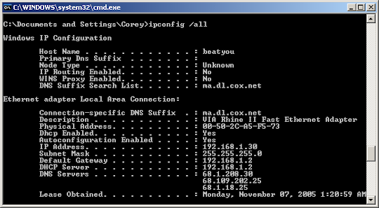
Local DNS name server
Each ISP (residential ISP, company, university) has one
  Also called “default name server”
When host makes DNS query, query is sent to its local DNS server
  Has local cache of recent name-to-address translation pairs (but may be out of date!)
  Acts as proxy, forwards query into hierarchy
Each ISP has local DNS name server; to find yours:
  MacOS: % scutil --dns
  Windows: >ipconfig /all

Slide 25
DNS name resolution: iterated query
root DNS server
Example: host at engineering.nyu.edu wants IP address for gaia.cs.umass.edu
2
3
TLD DNS server
Iterated query:
contacted server replies with name of server to contact
“I don’t know this name, but ask this server”
1
4
8
5
requesting host at
engineering.nyu.edu
local DNS server
dns.nyu.edu
gaia.cs.umass.edu
7
6
authoritative DNS server
dns.cs.umass.edu

Slide 26
DNS name resolution: recursive query
root DNS server
Example: host at engineering.nyu.edu wants IP address for gaia.cs.umass.edu
2
3
7
6
Recursive query:
puts burden of name resolution on contacted name server
heavy load at upper levels of hierarchy?
1
TLD DNS server
8
requesting host at
engineering.nyu.edu
local DNS server
dns.nyu.edu
5
4
gaia.cs.umass.edu
authoritative DNS server
dns.cs.umass.edu

Slide 27
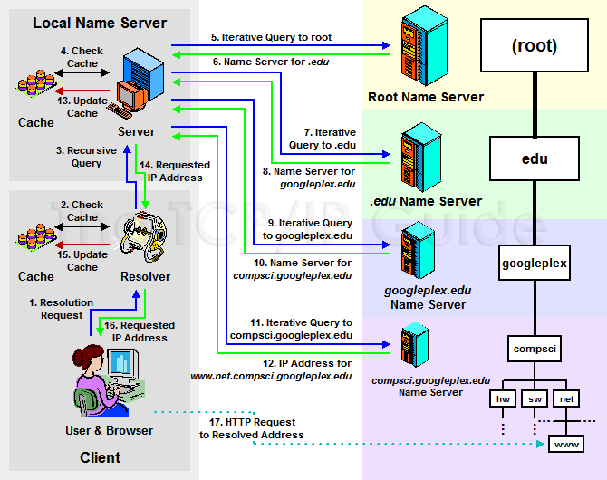
DNS Queries - Summary
Source :https://foxutech.com/what-is-dns-and-how-it-works/how-dns-works/

Slide 28
DNS: caching, updating records
Caching: When a name server learns an IP address for a domain, it saves (caches) this information for faster access next time.
TTL (Time to Live): Cached information has a lifespan (TTL) and removed from the cache after this time, requiring a fresh lookup.
Local Caching: Local name servers often cache TLD (Top-Level Domain) records to reduce the load on root servers.
Out-of-Date Cache: Cached entries might be outdated if a domain’s IP address changes. The change only becomes known across the internet once all caches with the old IP expire.
Updating Standard: There’s an IETF standard (RFC 2136) for updating DNS records to address this issue, allowing quicker updates across servers.

Slide 29
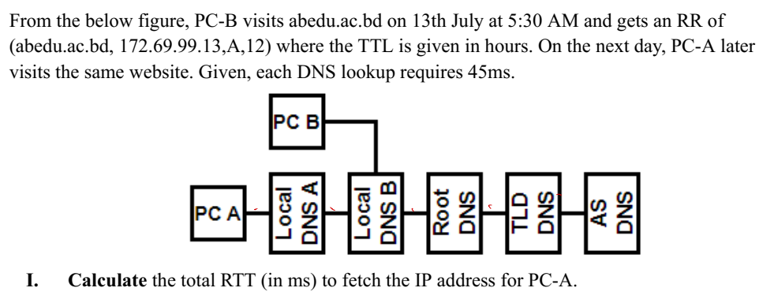
TTL expires
Total RTT: 5*45

Slide 30
DNS Records
Alias cannot have A, NS, MX RR
DNS: Distributed database storing resource records (RR)
RR format: (name, value, type, ttl)
type=A
  Name is hostname
  Value is IP address
  (google.com, 172.10.12.32, A)
type=CNAME
  Name is alias name for some “canonical” (the real) name
  Value is canonical name
  (www.google.com, google.com, CNAME)
  (myshop.com, shop.com, CNAME)
  (dailyshop.com, shop.com, CNAME)
  (groceries.com,shop.com, CNAME)
type=NS
  Name is domain
  Value is hostname of
  authoritative name server
  for this domain
  (google.com, dns.google.com, NS)
type=MX
  Value is name of mail server associated with name
  (google.com, mail.google.com,MX)
  (mail.google.com,172.10.12.39, A)

Slide 31
Example: new startup “Network Utopia”
Register name networkuptopia.com at DNS registrar (e.g., Network Solutions)
Network Utopia : Web Server
    (networkutopia.com, 212.212.71.4, A)
  CNAME :
  (www.networkutopia.com, networkutopia.com, CNAME)
  Registrar inserts a RR into .com TLD server:
    Local Primary DNS Server
  (networkutopia.com, dns1.networkutopia.com, NS)
    Email Server
  (networkutopia.com, mail.networkutopia.com, MX)
  (mail.networkutopia.com, 212.212.73.6, A)

Slide 32
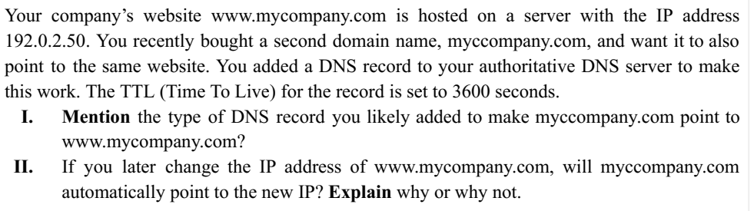
I. CNAME
II. Yes

Slide 33
I. Mention the type of DNS record you updated for www.mycompany.com.
II. Explain why some users might still reach the old IP address even after the update, even though your authoritative DNS server has the correct new IP
Your company’s website, www.mycompany.com, is hosted on a server with IP address 192.0.2.50. You updated the DNS record on your authoritative DNS server to point to a new IP address: 203.0.113.75. The record’s TTL (Time to Live) is set to 3600 seconds.
I. A
II. Stalled DNS cache as TTL has not expired yet

Slide 34
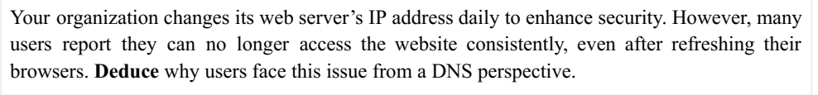
TTL did not expire, hence the old IP address remains in the browswer.

Slide 35
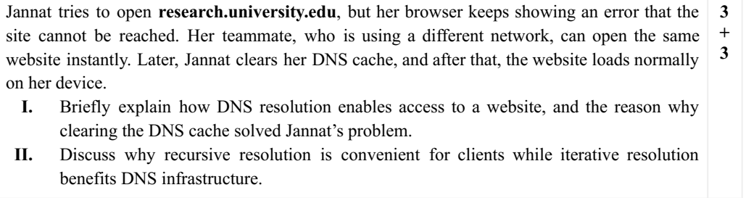
I. Converting domain name to IP address,
Stale DNS cache, the IP address of the research server was changed.
II. Just ask and get the results, all tasks are done by others.
Clients contact all DNS servers, the work burden on DNS servers is reduced.

Slide 36
THE END OF EMAIL AND DNS

